Slide 1



Generative AI Newsletter
Slack Chanel: #GENAI
February 21, 2024
What You Will Read:
Page 2: Top News Of The Week
Page 3: Latest Large Language Model Paper
Page 4: AI in Production
Page 5: Top LLM GitHub Repos
Page 6:
Page 7: Be A Prompt Engineer
Page 8: GLOSSARY
Latest NEWS/Article and Paper on GENRATIVE AI
As we enter the new year, we are thrilled to announce that our company has experienced significant growth and success in Q1 2023.
Our hardworking team has successfully implemented new strategies and projects, resulting in an increase in revenue and market share.
THIS CAN BE FILLED WITH A
1
INTRODUCTION

Slide 2

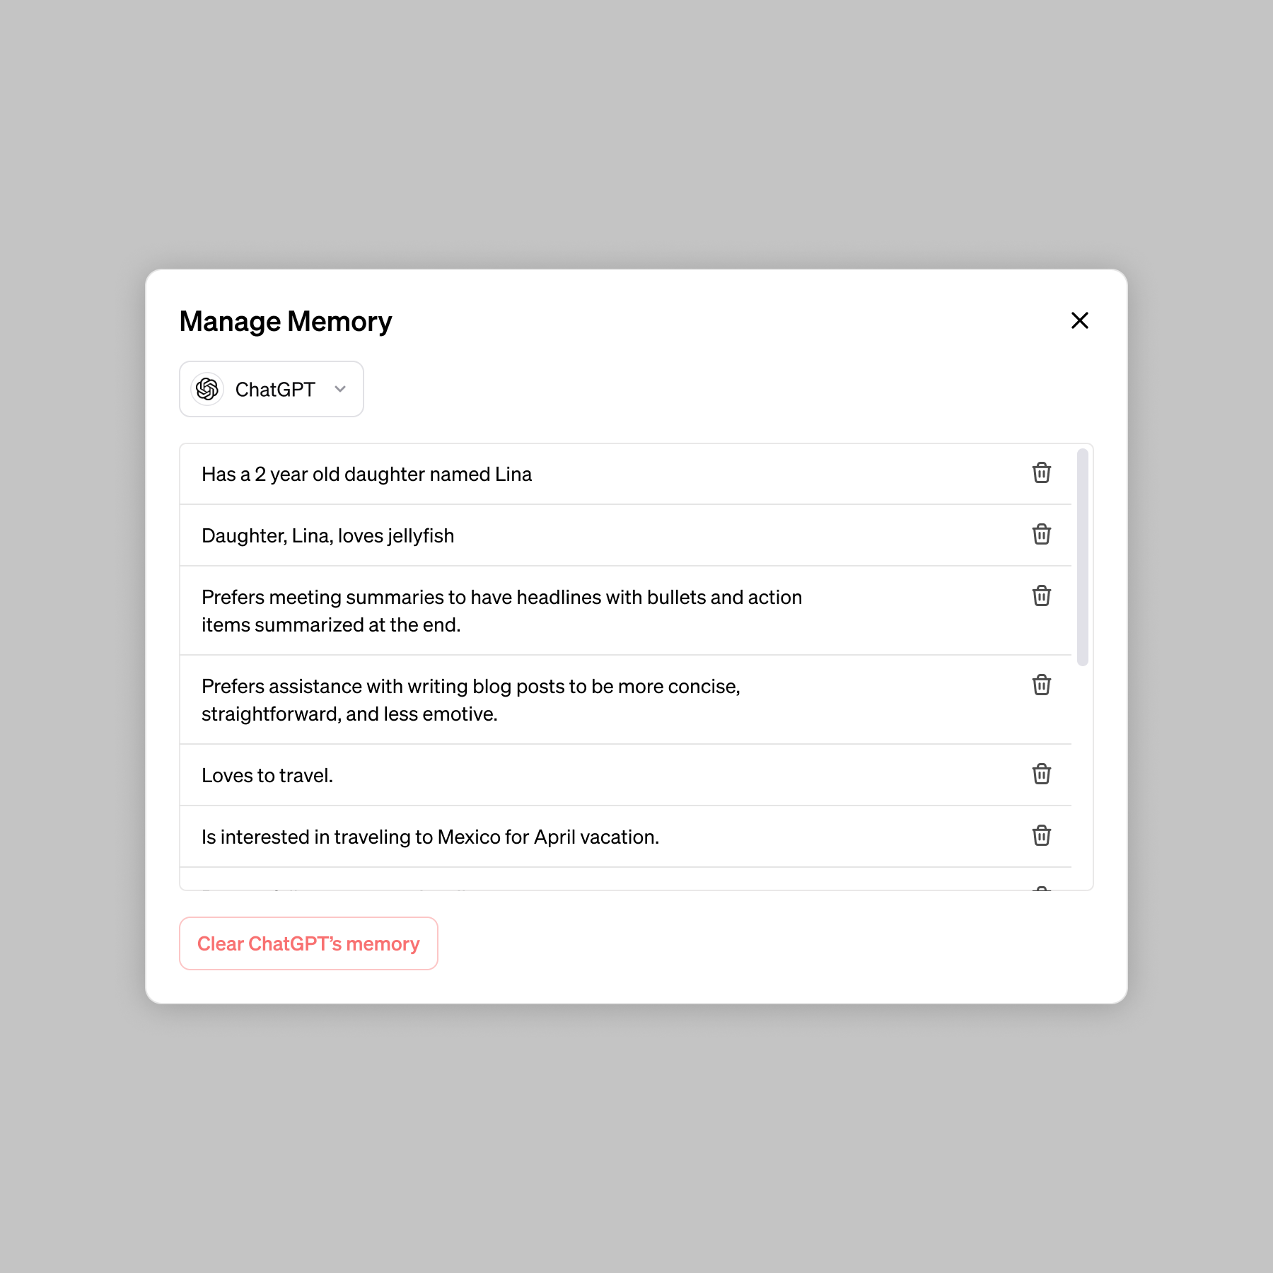
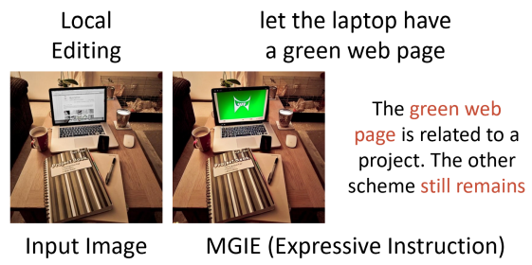

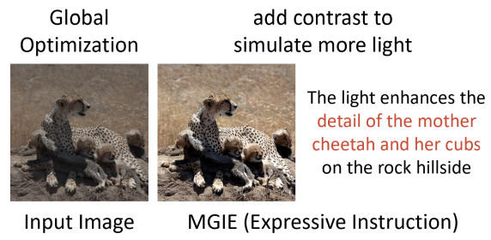

513M-item dataset. Developed by 3,000
researchers, Aya is one of the largest open science endeavors in machine learning to date. The result is a fully open-sourced dataset and model.
https://cohere.com/research/aya
Apple Releases ‘MGIE’, an Instruction-Based Image Editing Model
OpenAI Adds Memory to ChatGPT
OpenAI's latest ChatGPT update introduces memory across chats, enhancing personalization. Users can manage, delete, or disable this feature, ensuring privacy. Initially limited to select users, a wider rollout is planned, aiming to improve user experience with controlled data handling.
https://openai.com/blog/memory-and-new-controls-for-chatgpt
Cohere Announces Aya, A Massive Multilingual LLM
Cohere For AI launched Aya, an open-source, multilingual LLM covering 101 languages, with a
Apple unveiled MGIE, an open-source AI for instruction-based image editing using multimodal large language models (MLLMs) for natural language processing and pixel-level manipulation. MGIE allows Photoshop-style modifications and both global and local photo optimizations through expressive, instruction-derived edits.
https://huggingface.co/spaces/tsujuifu/ml-mgie
2
Link:
TOP NEWS OF THE WEEK
Notes:
Done!

Slide 3
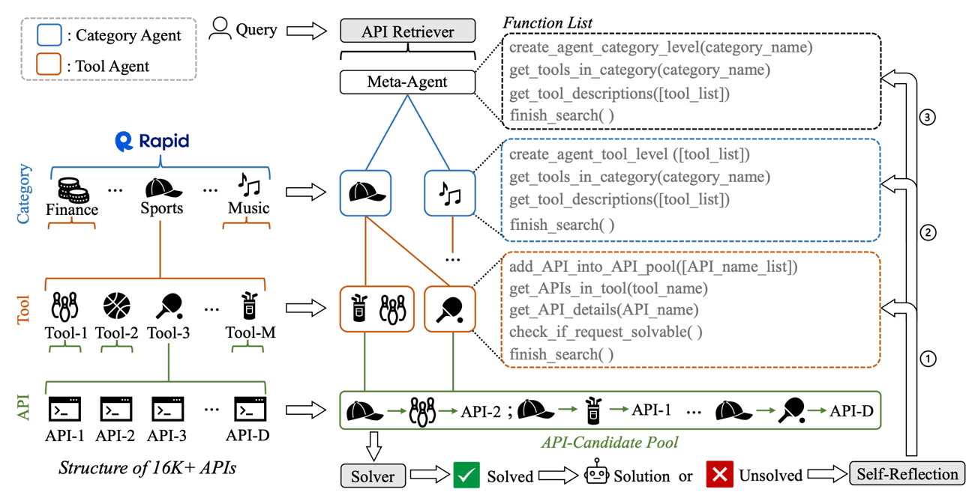
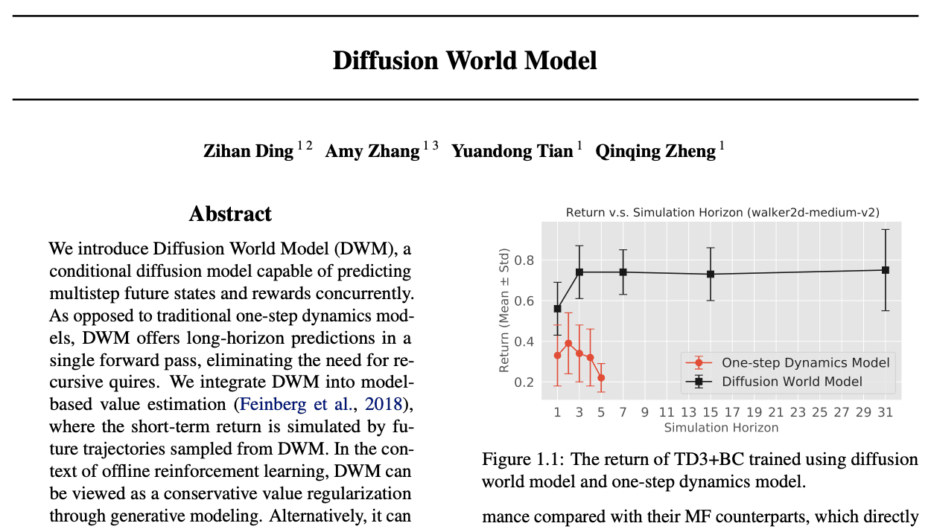
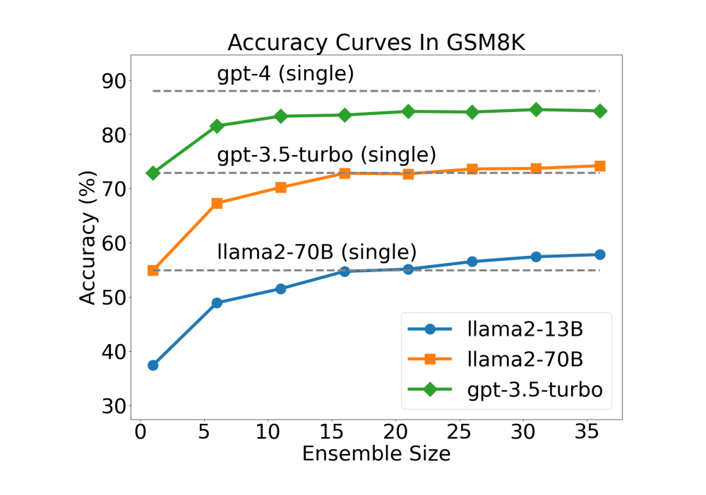
More Agents Is All You Need
This paper introduces a method that significantly enhances Large Language Model (LLM) performance by scaling up the number of agents using a sampling-and-voting approach. It shows a direct correlation between agent count and task performance improvement, making LLMs more efficient in complex problem-solving without needing complex frameworks.
The researchers tackled this issue by implementing a straightforward method of adding more instantiated agents and applying a sampling-and-voting technique. This approach is complementary to existing methods, allowing for combined use for further performance gains. The study also explores task difficulty dimensions to optimize agent scaling effectively.
Full Article: https://arxiv.org/pdf/2402.05120.pdf
AnyTool: Self-Reflective, Hierarchical Agents for Large-Scale API Calls
AnyTool introduces a method to utilize over 16,000 APIs from Rapid API for solving user queries efficiently. AnyTool's solution is threefold: First, a hierarchical API retriever narrows down relevant APIs, reducing search scope. Second, a solver uses these APIs to address queries. Third, a self-reflection mechanism re-engages AnyTool if initial solutions fail. This approach avoids the need for external module training, leveraging GPT-4's function calling.
AnyTool showcases superior performance by outperforming ToolLLM and GPT-4 variants with a 73.8% success rate on AnyToolBench, a 35.4% increase over ToolLLM. This demonstrates AnyTool's efficiency in managing and utilizing a vast API pool, offering a scalable solution for real-world application scenarios.
Full Article: https://arxiv.org/pdf/2402.04253.pdf
Diffusion World Model
Meta's Diffusion World Model (DWM) introduces a groundbreaking approach to predict multistep future states and rewards concurrently, outperforming traditional one-step dynamics models by a substantial 44%. This enhancement facilitates long-horizon predictions efficiently in a single forward pass.
In experiments on the D4RL dataset, DWM showcased significant advantages, including a 44% performance improvement over traditional models and achieving state-of-the-art results. It demonstrated notable robustness in long-horizon simulations, maintaining high performance even with extended prediction horizons, confirming its efficacy in complex predictive tasks.
Full Article: https://arxiv.org/pdf/2402.03570.pdf
3
LATEST LARGE LANGUAGE MODEL PAPER
Notes:
Done!

Slide 4


Don't Miss The Best Web Conference: AI in Production
Large Language Models have taken the world by storm. But what are the real use cases? What are the challenges in productionizing them?
In this event, you will hear from practitioners about how they are dealing with things such as cost optimization, latency requirements, trust of output and debugging.
70+ speakers from tech companies like Netflix, Uber, Doordash, Microsoft, Google, LinkedIn, Databricks and also top AI startups like Perplexity AI, HuggingFace and Cohere.
The event is 100% virtual taking place on Thursdays 22nd
3 tracks: one for engineering, one for AI product folks and one workshop track
The breaks will be full of live musical improv, games and guided meditations
The best part? It's completely free.
https://home.mlops.community/public/events/ai-in-production-2024-02-15
4
AI in Production

Slide 5

shell_gpt (☆ 7.4k)
ShellGPT, powered by GPT-4, helps you generate shell commands, code snippets, and documentation directly from the command line, streamlining your workflow. It supports major shells and OSes, with options for using OpenAI's API or local models.
https://github.com/TheR1D/shell_gpt
Metavoice-src (☆ 2.1k)
MetaVoice-1B helps you generate human-like, emotionally expressive speech in English, including zero-shot voice cloning for American and British accents with just 30s of reference audio. It's built on a 1.2B parameter model trained on 100K hours of speech data, supporting cross-lingual voice cloning and long-form synthesis.
https://github.com/metavoiceio/metavoice-src
Phidata (☆ 2.1k)
Phidata helps you build AI assistants through function calling, integrating tools like Streamlit, FastAPI, and databases for AI applications. You can create, serve, and extend functionalities with pre-built or custom functions, streamlining the development of AI-driven solutions.
https://github.com/phidatahq/phidata
CrewAI (☆ 7.5k)
CrewAI helps you orchestrate AI agents to work together, simulating a crew. You can build smart platforms or automated services by leveraging role-based collaboration and shared goals. It simplifies integrating multiple AI models and supports customization with open-source tools.
https://github.com/joaomdmoura/crewAI
Apple ml-mgie (☆ 3.3k)
MGIE helps you edit images through natural language instructions, leveraging multimodal large language models for pixel-level manipulations. It combines expressive instruction derivation with visual imagination for effective editing, optimized in an end-to-end training scheme. It supports Photoshop-style modifications, global photo optimization, and local edits.
https://github.com/apple/ml-mgie
5
TOP LLM GITHUB REPOS
Notes:
Done!

Slide 6


OpenAI Unveils Sora
OpenAI unveils Sora, an innovative AI capable of generating videos from text prompts. Utilizing GPT-4 technology, Sora crafts realistic scenes and animates images with precision.
Sora marks a significant advancement in video content generation, enhancing creative possibilities while addressing ethical concerns. OpenAI's commitment to safety and innovation sets a new standard in the generative AI space.
Key Points:
Capabilities: Transforms text instructions into videos, animates stills, and extends videos.
Limitations: Challenges in simulating complex physics and maintaining accuracy.
Safety Measures: Rigorous testing for misuse and tools to detect misleading content.
Google Launched Gemini 1.5 Pro
Gemini 1.5 Pro represents Google's commitment to pushing the boundaries of AI, enhancing both the scalability of tasks and the depth of interaction within digital environments.
Gemini 1.5 Pro represents Google's commitment to pushing the boundaries of AI, enhancing both the scalability of tasks and the depth of interaction within digital environments.
Key Points:
Advanced Performance: Matches the largest model to date, with significant improvements.
Expanded Capacity: Processes extensive text, video, audio, and large codebases effortlessly.
Innovative Learning: Adapts to new tasks without retraining, showcasing exceptional machine translation and coding problem-solving skills.
Safety Measures: Emphasizes responsible use with rigorous testing for content safety.
Exclusive Access: Initially available to select developers and enterprises, with consumer options on the horizon.
6
READING
Notes:
Done!

Slide 7


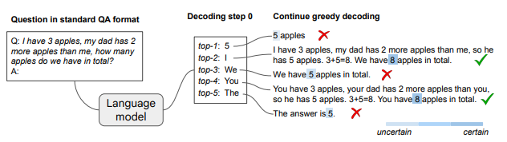
Chain-of-Thought Reasoning Without Prompting
This paper explores whether large language models (LLMs) can reason effectively without prompting. The study finds that CoT (chain-of-thought) reasoning paths can be elicited from pre-trained LLMs by altering the decoding process. Instead of using greedy decoding, the top-k alternative tokens during decoding frequently reveal CoT paths.
These paths indicate the model's reasoning abilities and are associated with higher confidence in the model's decoded answer. The proposed CoT-decoding approach significantly outperforms standard greedy decoding on various reasoning benchmarks. Main Points: 1. Large language models (LLMs) can reason effectively without prompting by altering the decoding process. 2. CoT reasoning paths can be naturally elicited from pre-trained LLMs by considering alternative top-k tokens during decoding. 3. CoT-decoding bypasses the confounders of prompting and allows assessment of LLMs' intrinsic reasoning abilities. 4. The presence of CoT paths during decoding is associated with increased confidence in the model's decoded answer. 5. CoT-decoding significantly outperforms standard greedy decoding on various reasoning benchmarks. 6. The choice of k, representing the number of alternative tokens considered, affects the performance of CoT-decoding. 7. CoT-decoding improves reasoning performance across math, natural language, and symbolic reasoning tasks. 8. CoT prompting techniques can teach models how to solve specific reasoning tasks, but CoT-decoding reveals the LLMs' intrinsic reasoning strategies. capabilities.
7
https://arxiv.org/pdf/2402.10200v1.pdf
BE A PROMPT ENGINEER

Slide 8

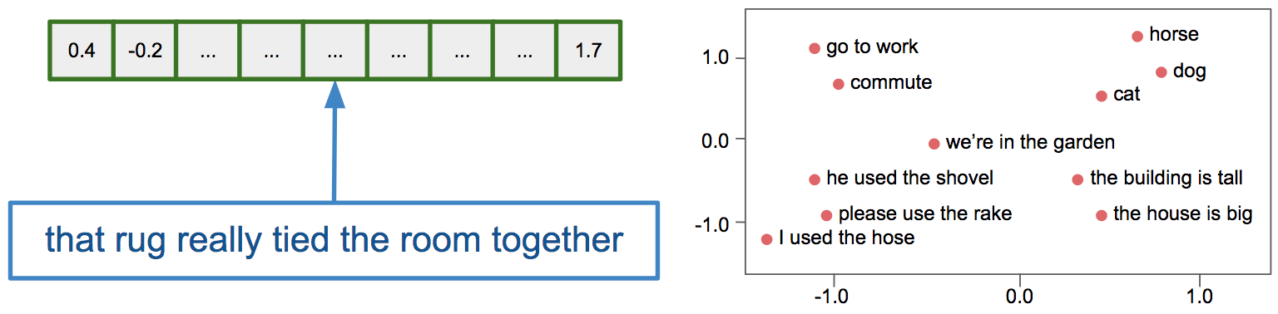
Attention:
A mechanism enabling models to focus on specific parts of the input sequence during processing, allowing them to weigh the significance of different words when generating output. This attention mechanism assists in capturing long-range dependencies and enhancing performance in various natural language processing (NLP) tasks.
BERT:
Bidirectional Encoder Representations from Transformers, a widely used pre-trained language model.
Gemini:
Google’s multimodal large language model (LLM), the first to outperform human experts on MMLU (Massive Multitask Language Understanding), a popular method for testing AI models’ knowledge and problem-solving abilities.
ChatGPT:
Chat Generative Pre-trained Transformer, developed by OpenAI, is a chatbot and a sibling model to InstructGPT, trained to follow instructions in a prompt and deliver detailed responses.
Embedding:
an NLP technique that maps a high-dimensional space, with a dimensionality equal to the total number of words, to a much lower-dimensional continuous vector space, assigning each word or phrase a vector in the real number domain.
Text embeddings convert any text into a vector of numbers (left). Semantically similar pieces of text are mapped nearby each other in the embedding space (right).
8
GLOSSARY
Notes:
https://arxiv.org/pdf/2401.17788v1.pdf Done

